Slide 1

LP for the island example
We want to plan the energy supply of an island, in order to meet its annual electricity demand
Annual electricity demand of the island: 250 kWyr
Source: Pexels.

Slide 2
LP for the island example
The island has two power plants, one is based on coal, and other is based on natural gas.
We want to know: how much each power plant should produce to meet the annual electricity demand of the island at minimum cost
Plant | Production decision variable (kWyr) | Fuel requirement per unit production (kWyr/kWyr) | Cost of production (USD/kWyr) | Fuel availability (kWyr)
Coal PP | XCL | 3 | 350 | 600 (coal)
Gas PP | XGS | 2 | 300 | 300 (gas)
Notes:
Let us collect the information we need to write the problem as a linear program:
Variables (which we must find the optimal value of): annual production of each power plant (Coal PP and Gas PP);
Objective function: minimize the annual production cost;
Constraints: max coal availability, max gas availability, min annual demand to be satisfied.

Slide 3
LP for the island example
Prerequisites
To carry out this task, GLPK and Notepad ++ must be installed on your computer.
Here you find the links to download and install the two packages for Windows OS.
GLPK: https://sourceforge.net/projects/winglpk/postdownload?source=dlp
Notepad ++: https://notepad-plus-plus.org/download/v7.5.4.html
We recommend to use a computer with Windows OS.

Slide 4
LP for the island example
Preparatory tasks
After download, find the GLPK folder. Copy & paste it directly in the desktop, if it is not already there.
Open Notepad ++ and create two new text documents. Name them island_model.txt and island_data.txt. Save them inside the GLPK folder, in glpk\w64 or glpk\w32, depending on whether your system is 32 bit or 64 bit (you can find the information in the Control Panel).

Slide 5
LP for the island example
Definition of the optimisation model in GNU MathProg language
Open the island_model.txt file
First, declare a SET. The sets constitute the basic structure of your model, i.e. they list the basic elements. Here, we will define a set, which will later include the list of power plants (PP)
Command (you may copy-paste into the text file):
# Set and Problem declaration
set PP;
Remember:
text written after # and in between /*....*/ are comment lines: it will not be considered when the software is compiling
always end commands with ’;’ → otherwise the calculations will give an error

Slide 6
LP for the island example
Definition of the optimisation model in GNU MathProg language
Declare the parameters (user inputs) of this problem. In this case, they are fuel availability (fav), cost of production (cop) and fuel requirement (freq). Make sure that you always specify the suffix declaration, i in PP, between flower brackets {}
Command:
# Parameter definition
param fav {i in PP};
param cop {i in PP};
param freq {i in PP};

Slide 7
LP for the island example
Definition of the optimisation model in GNU MathProg language
Declare the parameters (user inputs) of this problem. In this case, they are fuel availability (fav), cost of production (cop) and fuel requirement (freq). Make sure that you always specify the suffix declaration, i in PP, between flower brackets {}
Command:
# Parameter definition
param fav {i in PP}; → it indicates that the parameter is defined for each i in the SET ‘PP’
param cop {i in PP};
param freq {i in PP};

Slide 8
LP for the island example
Definition of the optimisation model in GNU MathProg language
Declare the variables. In our case, we will define a variable x which, for every power plant i, will indicate its optimal production level.
Command:
# Variable definition
var x {i in PP} >=0;

Slide 9
LP for the island example
Definition of the optimisation model in GNU MathProg language
After declaring sets, parameters and variables, type your optimisation problem, i.e. the objective function and the constraints.
Command:
# Objective function
minimize z: sum{i in PP} cop[i]*x[i];
# Constraint Specification
s.t. Fuel {i in PP}: freq[i]*x[i]<= fav[i]; → note the constraints must always be introduced by ‘s.t.’ (subject to)
s.t. Production : sum{i in PP} x[i]>=250;

Slide 10
LP for the island example
Definition of the optimisation model in GNU MathProg language
Type the solve; and the end; statements, required at the end of every problem. Then click Save and close the file. Without these, the code will not run! Never forget them!
Command:
# Solve statement
solve;
# End statement
end;

Slide 11
LP for the island example
Definition of the optimisation model in GNU MathProg language
Summary of commands:
# Set and Problem declaration
set PP;
# Parameter definition
param freq {i in PP};
param cop {i in PP};
param fav {i in PP};
# Variable description
var x {i in PP} >=0;
# Objective function
minimize z: sum{i in PP} cop[i]*x[i];
# Constraint Specification
s.t. Fuel {i in PP}: freq[i]*x[i]<= fav[i];
s.t. Production : sum{i in PP} x[i]>=250;
# Solve statement
solve;
# End statement
end;

Slide 12
LP for the island example
Definition of the input data file in GNU MathProg language
Open the island_data.txt file
Now, assign alpha-numerical values for the SET and the parameters you defined. Then click Save and close the file.
Command:
# Set Defintion
set PP:=
coal
gas;

Slide 13
LP for the island example
Command (continues from slide before):
# Fuel Requirement info
param freq :=
coal 3
gas 2;
# Cost of production info
param cop:=
coal 350
gas 300;
# Fuel Availability info
param fav:=
coal 600
gas 300;
# End statement
end;

Slide 14
LP for the island example
Definition of the input data file in GNU MathProg language
Summary of commands
# Data section
data;
# Set Defintion
set PP:=
coal
gas;
# Fuel Requirement info
param freq :=
coal 3
gas 2;
# Cost of production info
param cop:=
coal 350
gas 300;
# Fuel Availability info
param fav:=
coal 600
gas 300;
# End statement
end;

Slide 15
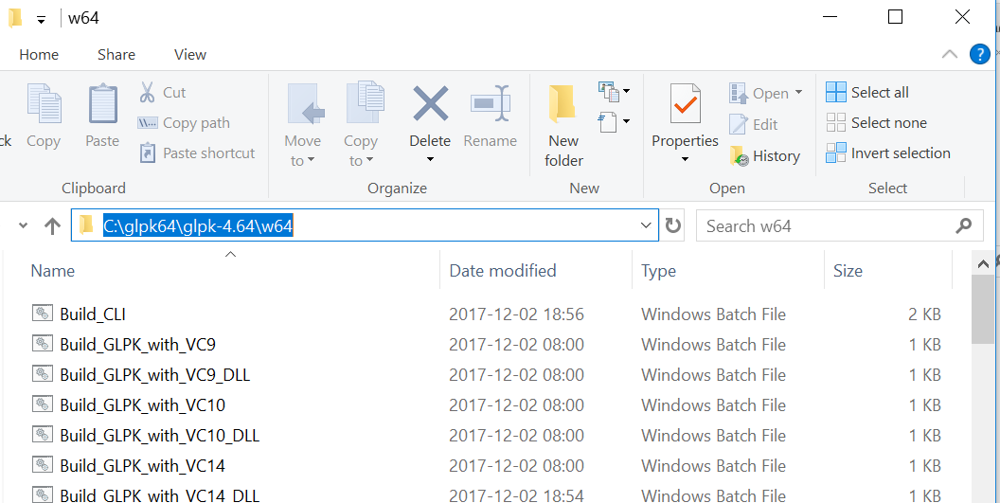
LP for the island example
Now, we solve the problem using the command prompt and GLPK
Copy the path of the glpk\w64 or glpk\w32 folder, by left-clicking on the top bar of the folder window, like in the screenshot below

Slide 16
LP for the island example
Now, we solve the problem using the command prompt and GLPK
Copy the path of the glpk\w64 or glpk\w32 folder, by left-clicking on the top bar of the folder window, like in the screenshot below
Open the command prompt (type cmd in the search bar of Windows)
Type cd, type a space and then paste the path of the glpk\64 or glpk\32 folder; press Enter
Type the command: glpsol –m island_model.txt –d island_data.txt –o island_results.txt
Press Enter
Through the command prompt, GLPK will solve the linear optimisation model you wrote.
It will take as input the island_model.txt file, the island_data.txt file, compute a solution and print it in the output file island_results.txt (which will appear in the same folder).

Slide 17
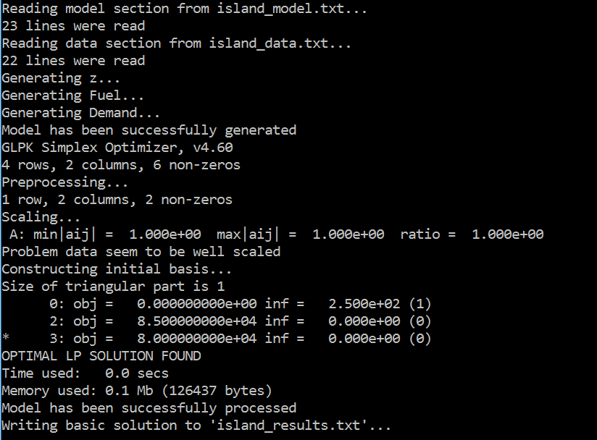
LP for the island example
Let us interpret the command prompt screen
Reading the model and data files
Generating the equations
Turning the equations into a linear matrix
Solving the system. Showing:
Objective value (final: 8.0e+04)
Residuals on the right
The ‘*’ indicating the solver is converging to a solution
Final solution message: OPTIMAL LP SOLUTION FOUND
Writing output file: island_results.txt

Slide 18
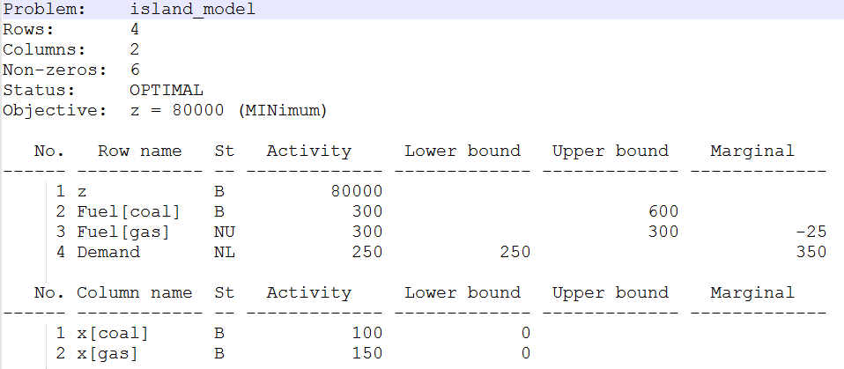
LP for the island example
Let us interpret the output file island_results.txt (you can find and open it in the glpk\w64 or glpk\w32 folder)
Problem (matrix) size
Objective value at convergence
Optimal value of independent variables

